Slide 1
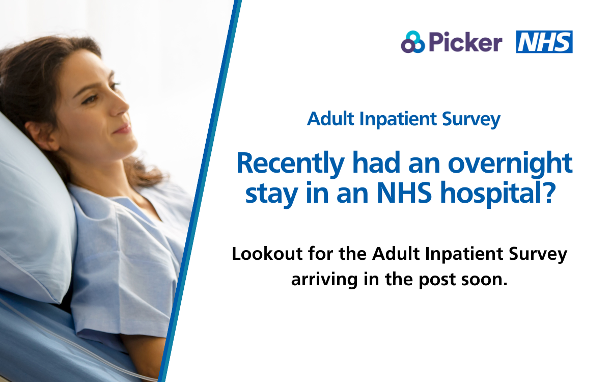
Adult Inpatient Survey
Recently had an overnight stay in an NHS hospital?
Make your voice heard.
Look out for the Adult Inpatient Survey arriving in the post soon.
The NHS Adult Inpatient Survey has Section 251 (NHS Act 2006) approval to process contact details.

Slide 2

Adult Inpatient Survey
Make a difference to NHS Adult Inpatient care.
We’d love to hear about your
experience of your overnight stay in hospital.
The NHS Adult Inpatient Survey has Section 251 (NHS Act 2006) approval to process contact details.

Slide 3

Adult Inpatient Survey
Take a moment to share your experience of your hospital stay.
Help shape the future of NHS care.
Look out for your Adult Inpatient Survey in the post.
The NHS Adult Inpatient Survey has Section 251 (NHS Act 2006) approval to process contact details.

Slide 4
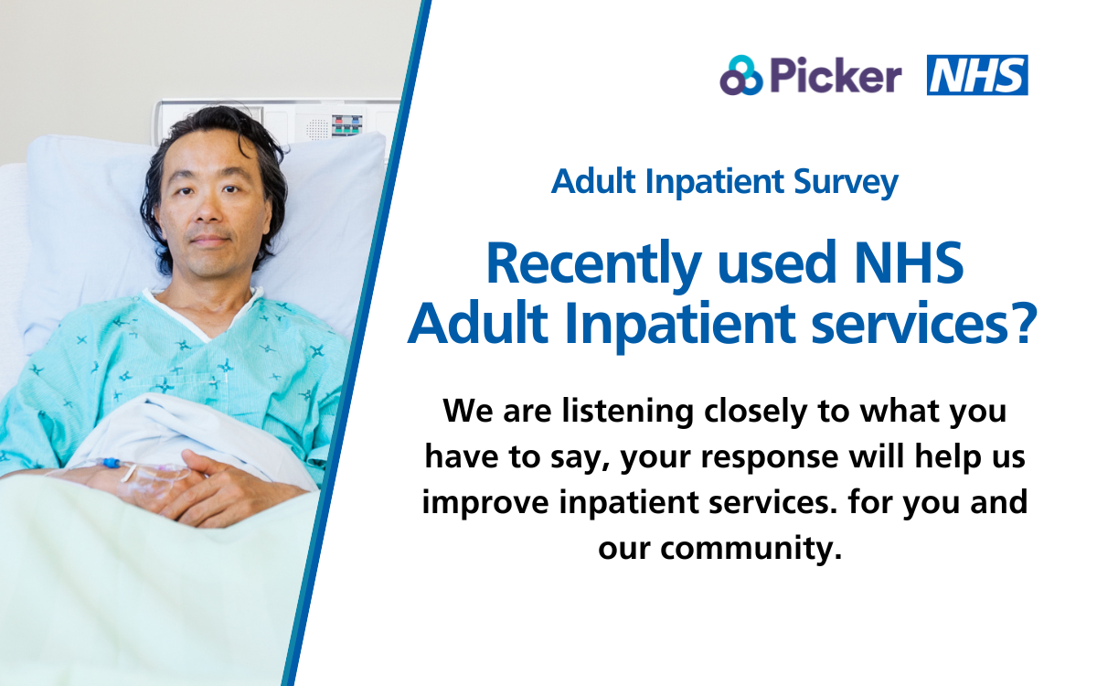
Adult Inpatient Survey
Help make hospital care better.
Every voice matters.
Your responses will help us improve our inpatient care.
The NHS Adult Inpatient Survey has Section 251 (NHS Act 2006) approval to process contact details.

